Slide 1

Lending Club Case Study:
Assessment By: Divakar & Vivek

Slide 2
OBJECTIVE
Identify the driving factors (or driver variables) behind loan default

Slide 3
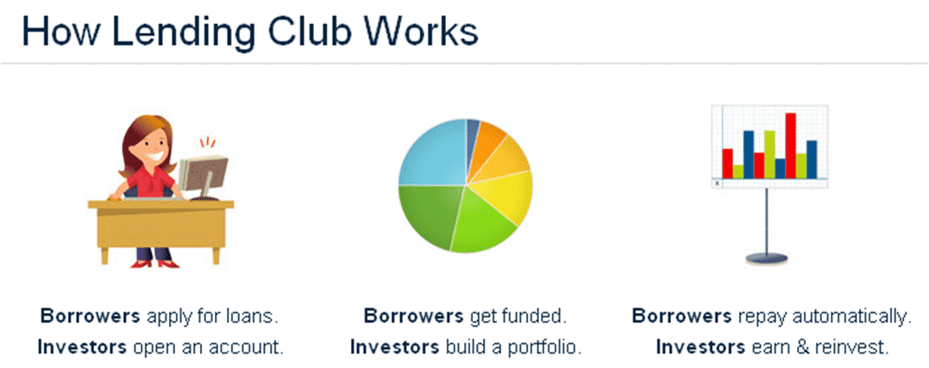
Lending Club: In Brief
What is Lending Club?
Lending Club is a marketplace for personal loans that matches borrowers who are seeking a loan with investors looking to lend money and make a return.
When the company receives a loan application, the company has to make a decision for loan approval based on the applicant’s profile. Two types of risks are associated with the bank’s decision:
If the applicant is likely to repay the loan, then not approving the loan results in a loss of business to the company
If the applicant is not likely to repay the loan, i.e. he/she is likely to default, then approving the loan may lead to a financial loss for the company
If one can identify these risky loan applicants, then such loans can be reduced thereby cutting down the amount of credit loss.
Identification of such applicant’s using EDA is the aim of this case study

Slide 4
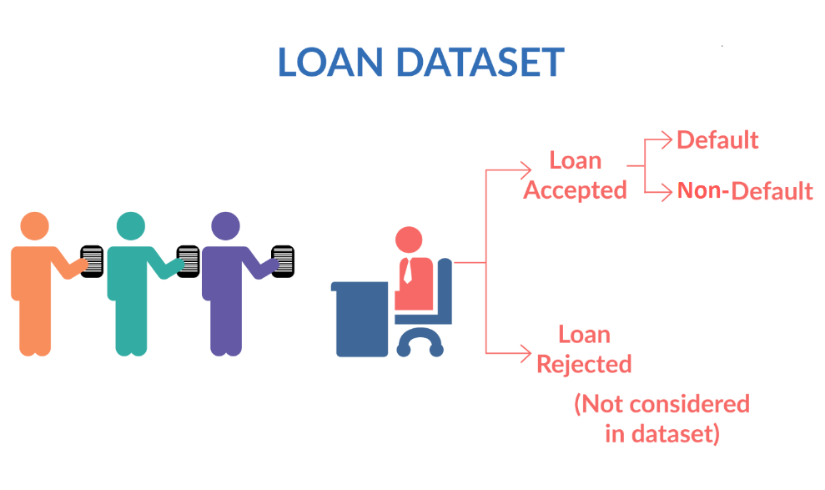
Lending Club: Loan Status
Fully paid: Applicant has fully paid the loan (the principal and the interest rate)
Current: Applicant is in the process of paying the instalments, i.e. the tenure of the loan is not yet completed. These candidates are not labelled as 'defaulted'.
Charged-off: Applicant has not paid the instalments in due time for a long period of time, i.e. he/she has defaulted on the loan

Slide 5
Lending Club: Dataset Critical Parameters
Parameters | Description | Parameters | Description
loan_amnt : | Amount applied by potential borrowers | annual_inc: | yearly income of the loan applicant
funded_amnt: | Amount recommended/approved by Lending Club | int_rate: | rate of interest of the availed loan
funded_amnt_inv : | Amount funded by investors | emp_length: | work experience of the loan applicant
dti: | Debt to Income ratio | verification_status: | income verification status of the loan applicant
grade: | loan classification based on interest rate | home_ownership: | loan applicant home ownership status
purpose: | purpose of loan such as car, house, vacation..etc | issue_d: | date of issue of loan
installment: | monthly EMI amount | term: | loan repayment EMI number of months
loan_status: | status of the loan Fully Paid/Charged Off/Current

Slide 6
Lending Club: Data Work Flow
Import Raw Loan dataset (“loan.csv”) to → “loands” variable.
Remove null value rows (referring “emp_length” column) from the dataset to create →“loands2”.
Drop rows based on outliers in “int_rate”,” installment” & ” loan_amnt” in loands2 dataset
Drop less important columns from “loands2”.
Extract →“month” & “year” column from “issue_d”.
Convert →“int_rate” to float after removing % symbol
Generate →“exp_exper” column (“Beginner” / “Junior” / “Senior” / “Vsenior”) from the “emp_length”
Calculate →“monthly_inc” from the “annual_inc”
Calculate → “netcash_monthly” from the “monthly_inc”, “dti” & “installment”.
Drop → “Current” category rows based on loan status( “Charged Off”, “Fully Paid” and “Current”) to form →“loanNcur” for better correlations

Slide 7
Lending Club: Calculated Parameters
Calculated Parameter | Description
year: | year in which loan was applied. Extracted from “issue_d”
month: | month in which loan was applied. Extracted from “issue_d”
monthly_inc: | monthly income of the loan applicant. Calculated by “annual_inc”/12
netcash_monthly (NCM): | Net cash available with loan applicant after repaying debt monthly in percentage. netcash_monthly= (monthly_inc- installment- (dti*monthly_inc)/100)*100/monthly_inc
emp_exper : | loan applicant work experience category. Calculated from “emp_length”. emp_length (0 – 2yrs) :Beginner emp_length (3 – 5yrs) :Junior emp_length (6 – 9yrs) :Senior emp_length (>=10yrs) :VSenior

Slide 8
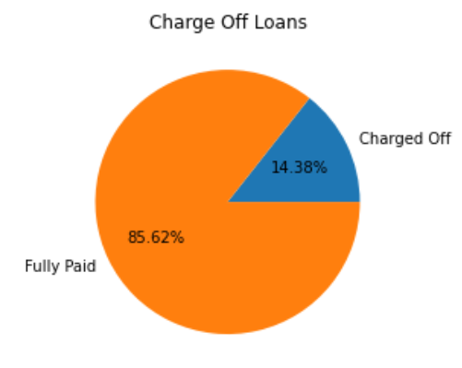
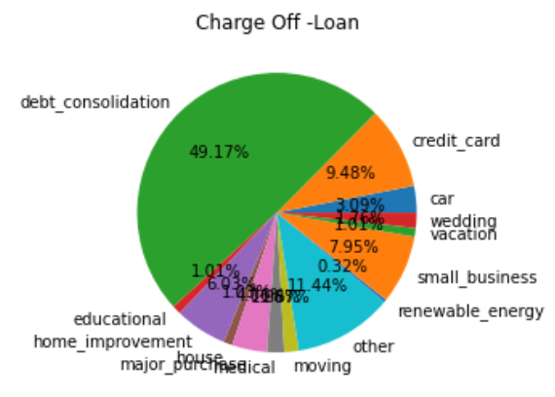
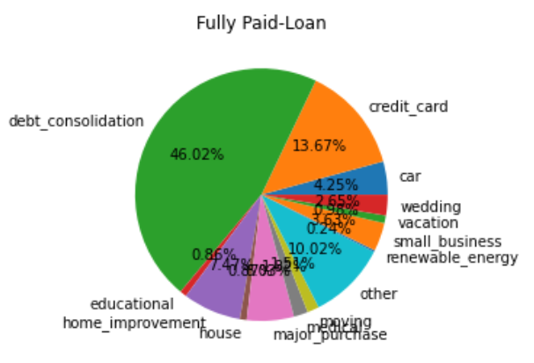
Lending Club: Total Charged Off Loans
Total Loans from the dataset: 39717
“Fully Paid” Loans: 32950
“Charged Off” Loans: 5627
“Current” Loans: 1140

Slide 9
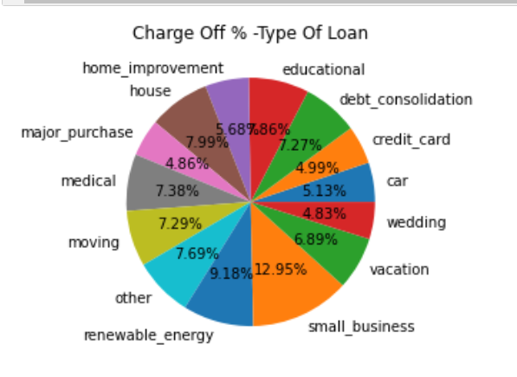
Lending Club: Defaulter %- On Loan Types
Looking at the defaulter’s distribution based on their loan’s availed
In terms of %
“Small_business” type of loan contributes the highest % of defaulters
Followed by “renewable_energy”
House, educational, other, medical, moving, debt_consolidation, & vacation type of loans show similar % defaulters
In terms of volume,
“debt_consolidation” loan contributes to nearly 49.2% of defaulters,
followed by “home_improvement” and “other” loans

Slide 10
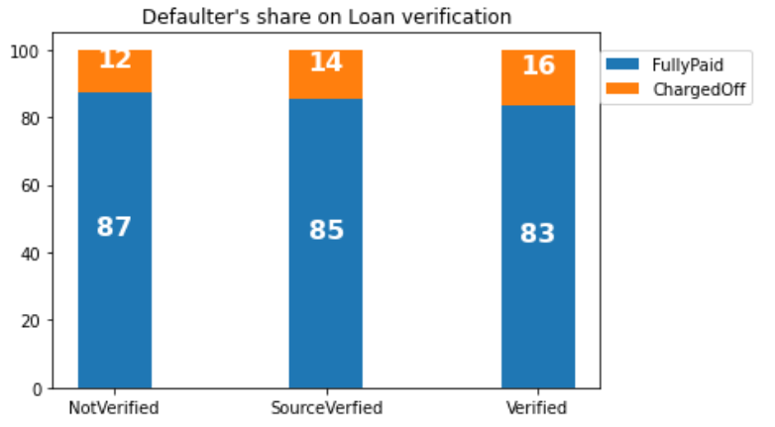
Lending Club: Defaulter %- On Loan verfication status
Loans applicant’s income are usually verified, and status is categorized as Verified, Not Verified and Source Verified
According to the income verification status, when we plot the defaulter’s distribution, we can’t see much difference between “Verified” & “Not Verified” loans.
The trend shows slightly reverse belief. Instead of “NotVerified” , “Verified” loans has slightly high defaulters.

Slide 11
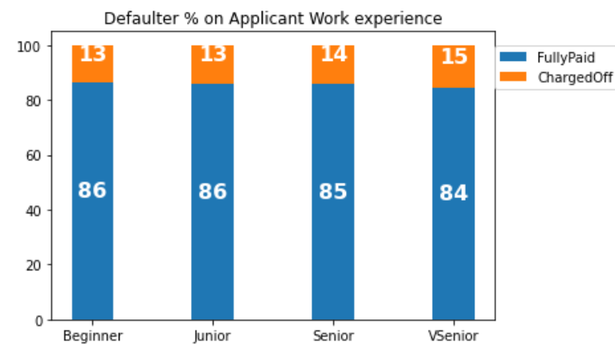
Lending Club: Defaulter %- On Loan Applicant Experience
Based on applicant’s employment length they are grouped as Beginners Junior, Senior and VSenior. When we plot the defaulter’s % distribution based on work experience
We don’t see much difference in the applicant defaulting behavior based on their experience.
We expected a lower defaulting % with increasing experience, but the results are slightly reverse

Slide 12
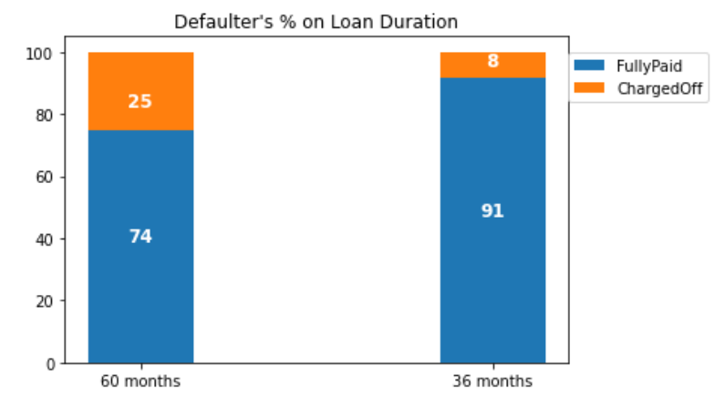
Lending Club: Defaulter %- On Loan Duration
The applicant can choose between 60-month term loan or 36-month term loan. When we plot the defaulter’s % distribution based on the loan term
We see 300% more defaulters in 60 months loan when compared to 36 months loan.

Slide 13
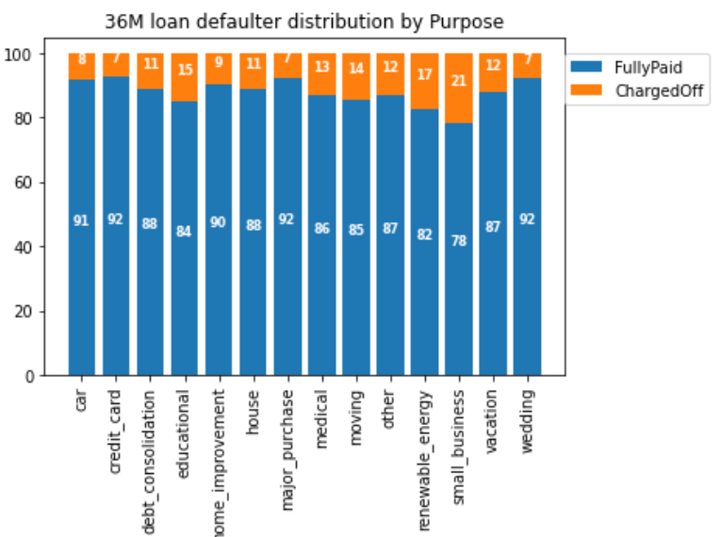
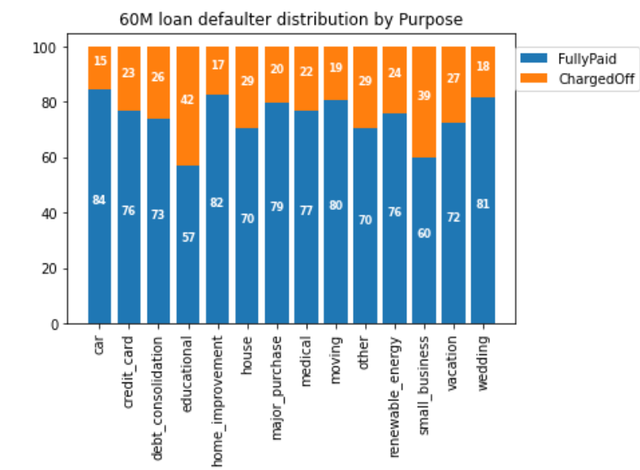
Lending Club: Defaulter %- On Loan Duration & Purpose
When we perform bivariate analysis on loan defaulter w.r.t loan term and loan purpose, we can understand the following
On an average loan defaulters in 60-month term is twice/thrice that of 36-month loan irrespective of the purpose of the loan
Educational and Small business type of loan has the highest % of defaulter

Slide 14
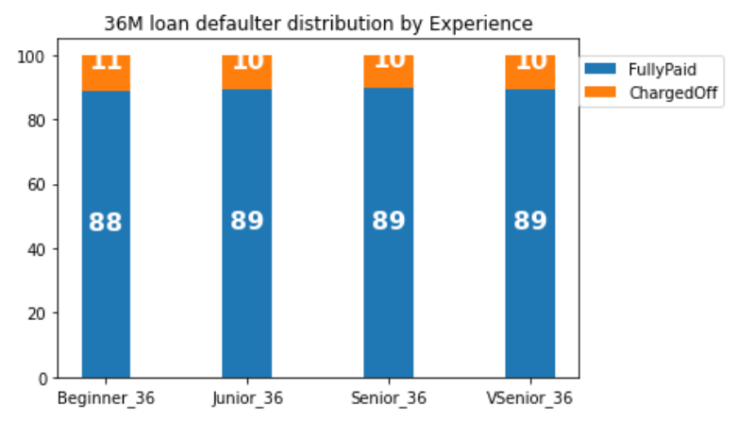
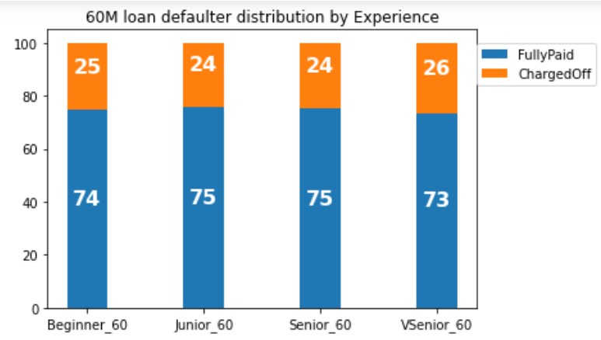
Lending Club: Defaulter %- On Loan Duration & Experience
When we perform bivariate analysis on loan defaulter w.r.t loan term and applicant experience, we can understand the following
On an average loan defaulters in 60-month term is twice/thrice that of 36-month loan irrespective of the loan applicant experience

Slide 15
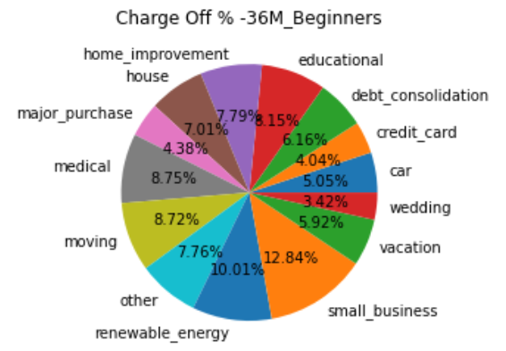
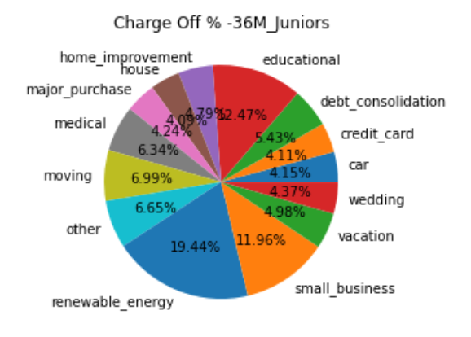
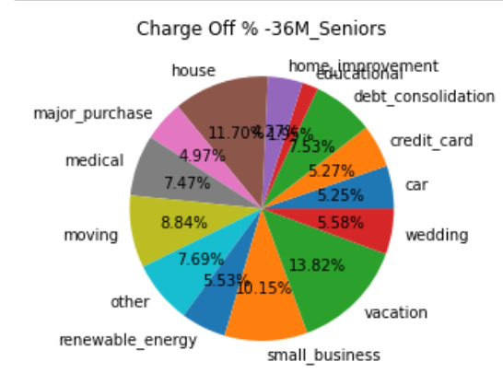
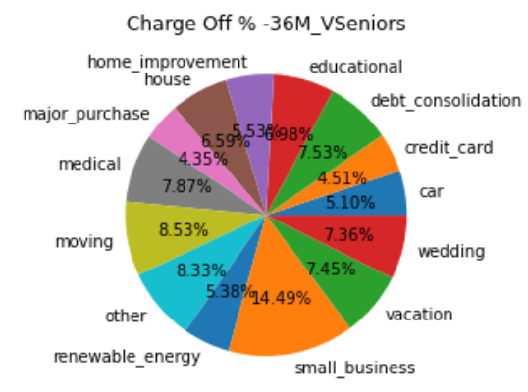
Multivariate Analysis on 36M-Loan Defaulter % - Loan Term, Experience & Purpose
36 month loan defaulter’s
“Renewable Energy” loan contributes max % of defaulters in Beginners and Juniors
Defaults in “Small_business” loans are highest in all experience
Seniors seems to default more in housing loan & and vacation loan.

Slide 16
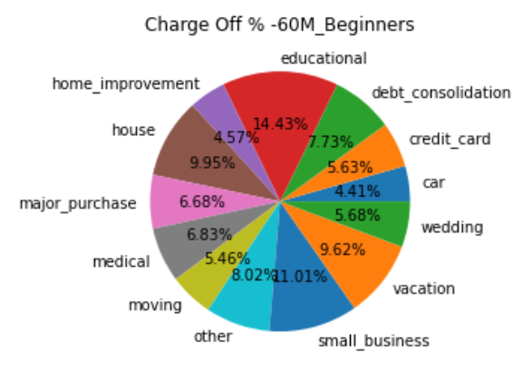
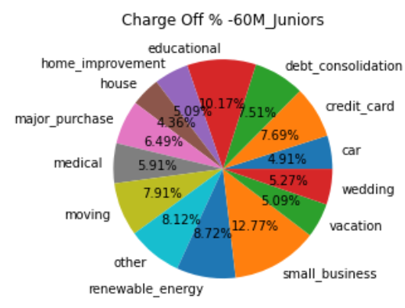
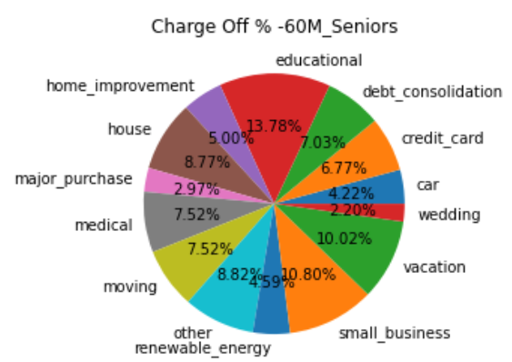
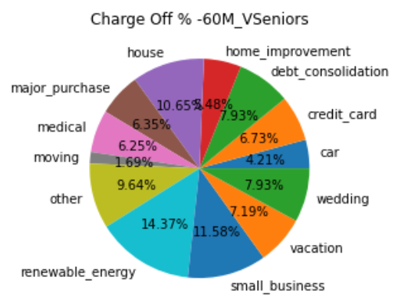
Multivariate Analysis on 60M-Loan Defaulter % - Loan Term, Experience & Purpose
60- month loan defaulter’s
“Educational” loan contributes max % of defaulters in Beginners, Juniors and seniors
Defaults in “Small_business” loans are highest in all experience
Seniors seems to default more in housing loan & and vacation loan.
Vseniors seems to default more on renewable energy and house

Slide 17
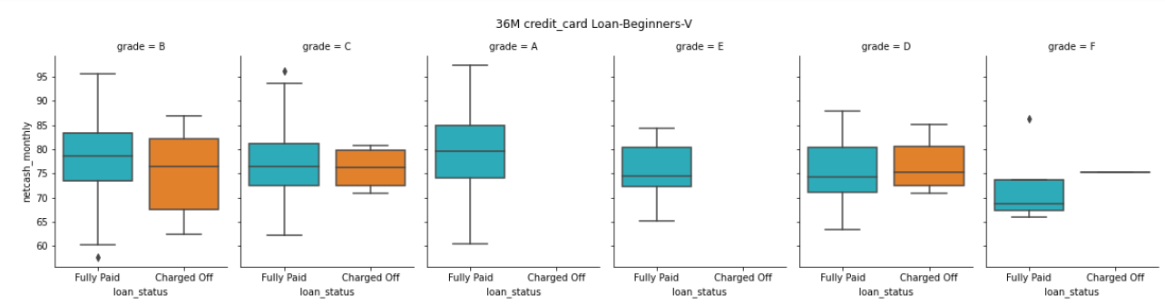
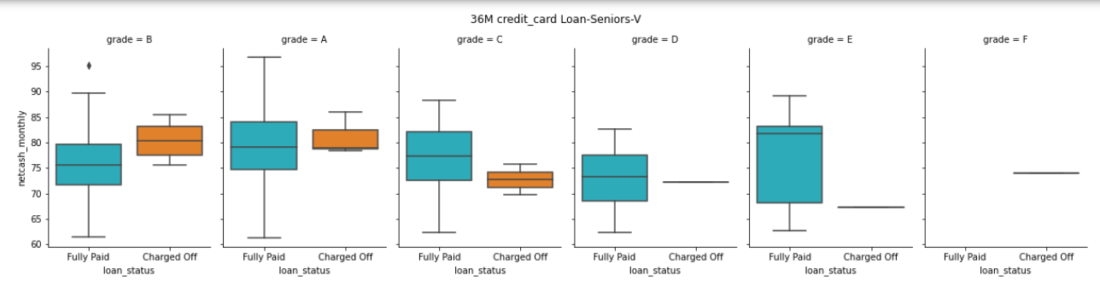
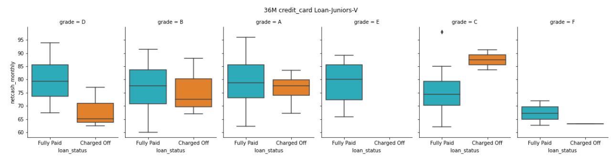
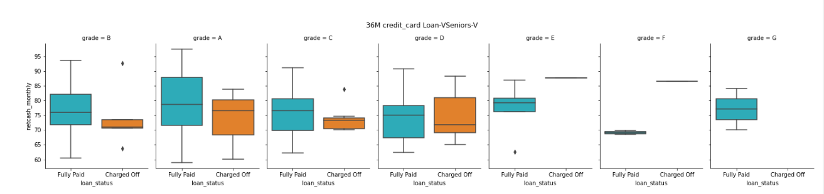
Multivariate Analysis: 36M-Credit Card Loan
High possibility of default by:
Applicants availing “A5”, “B” , “C”, “D” grade loan with NCM <75%
Not-Verified loan applicants

Slide 18
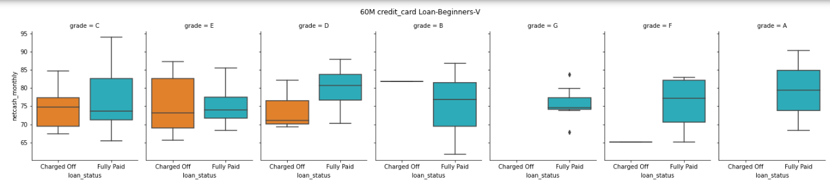
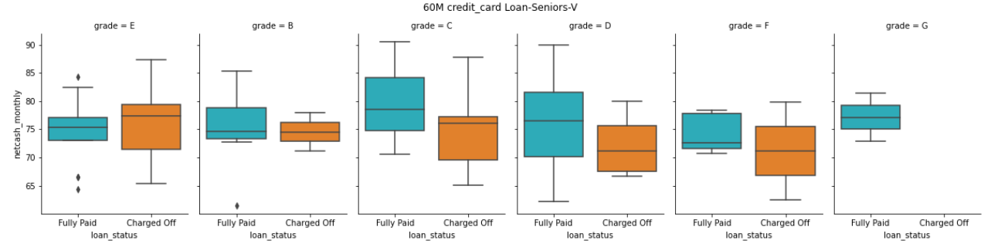
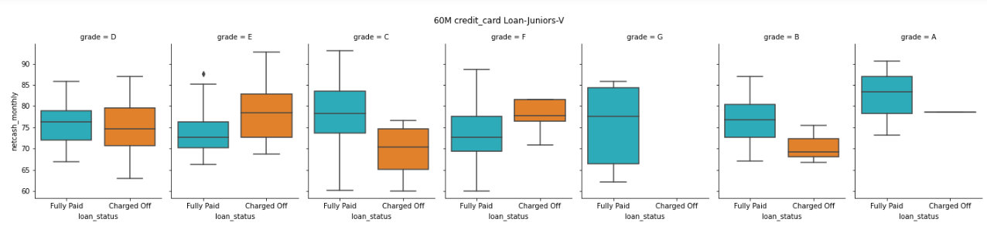
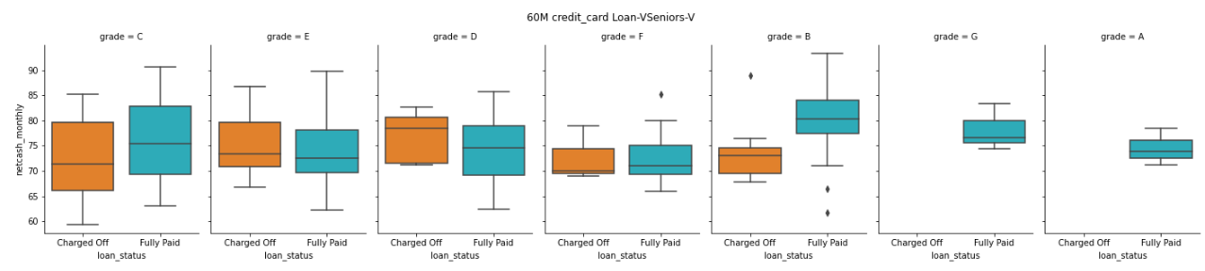
Multivariate Analysis: 60M- Credit Card Loan
High possibility of default by:
Applicants availing “B4”, “C”, “D”, “E” grade loan with NCM <78%

Slide 19
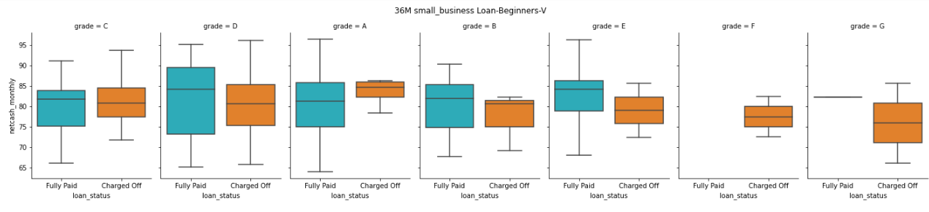
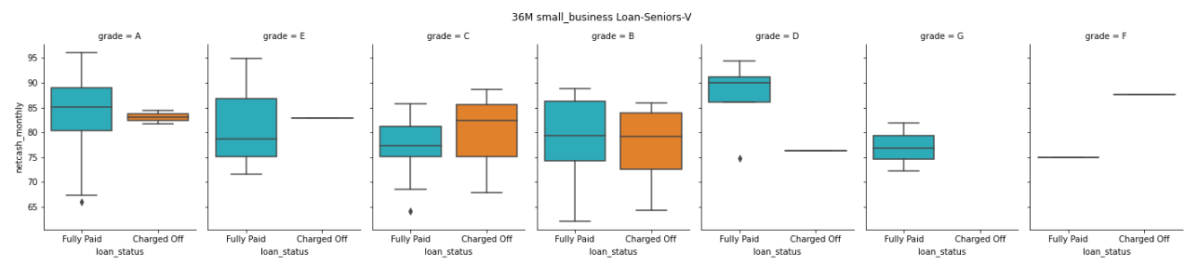
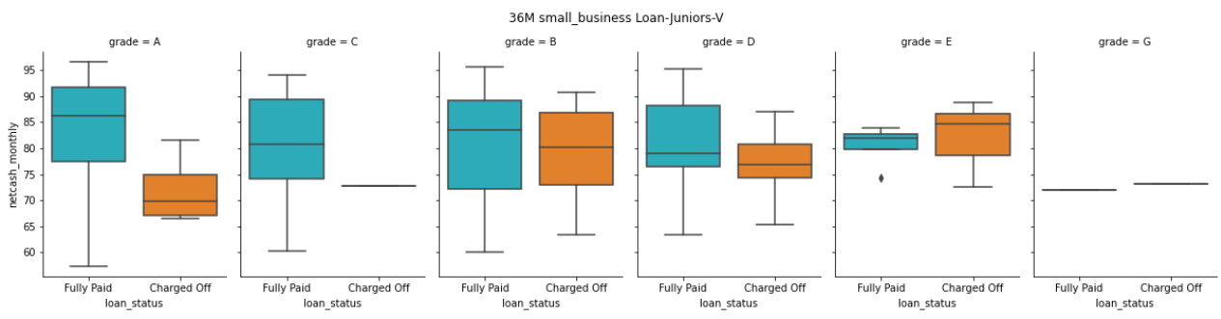
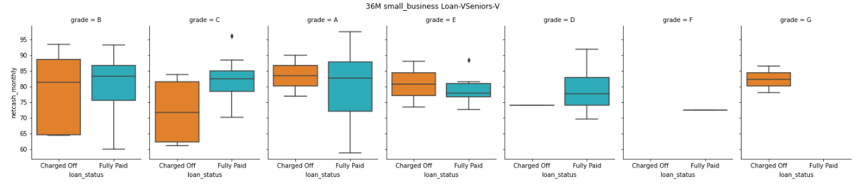
Multivariate Analysis: 36M- SmallBusiness Loan
High possibility of default by:
Applicants availing “C”, “D” grade loan who posses NCM <80%
Applicants availing “B” grade loan with NCM <78%

Slide 20
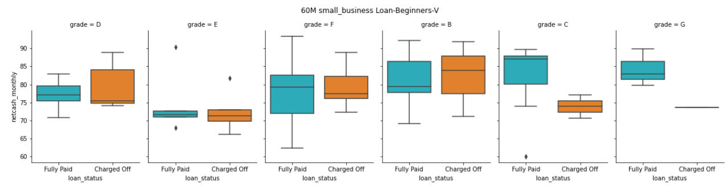
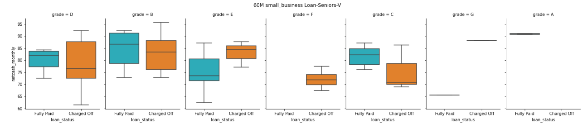
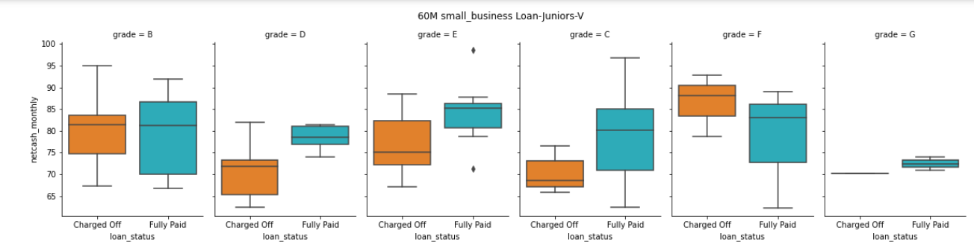
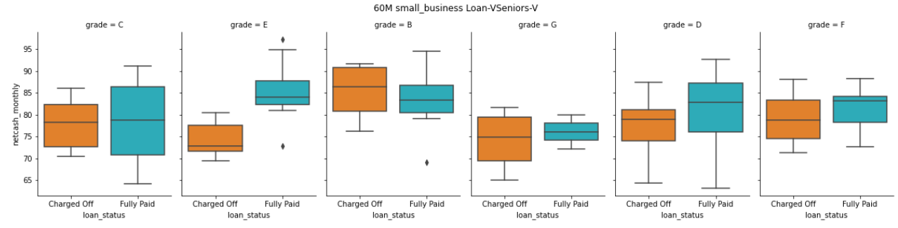
Multivariate Analysis: 60M-SmallBusiness Loan
High possibility of default:
More % of defaulters compared to same 36M loan
Applicants availing “B”, ”F” grade loan who posses NCM <82%
Applicants availing “C” , “G” grade loan who posses NCM <76%
Applicants availing “D”, “E” grade loan who posses NCM <80%

Slide 21
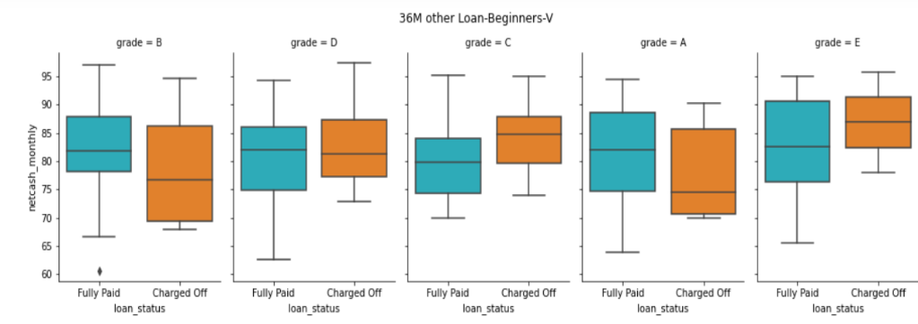
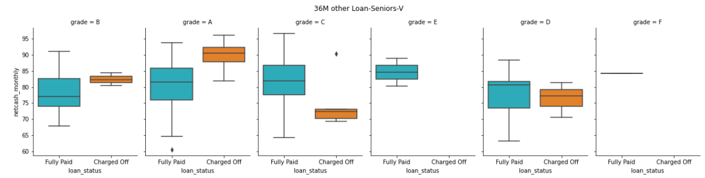
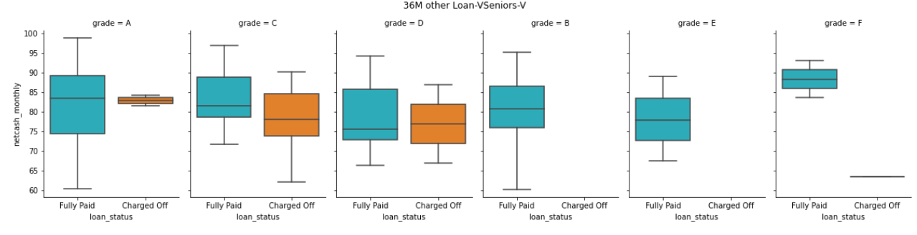
Multivariate Analysis: 36M-Other Loan
High possibility of default:
More % of defaulters in Not Verified Category
Applicant availing “B” grade loan who posses NCM <76%
Applicant availing “A” grade loan who posses NCM <80%
Applicants availing “C”, “D” grade loan who posses NCM <78%
Applicant availing “E” grade loan who posses NCM <85%

Slide 22
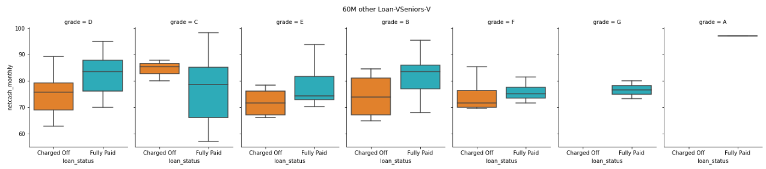
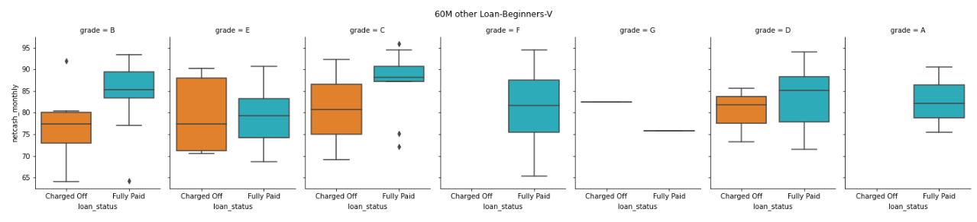
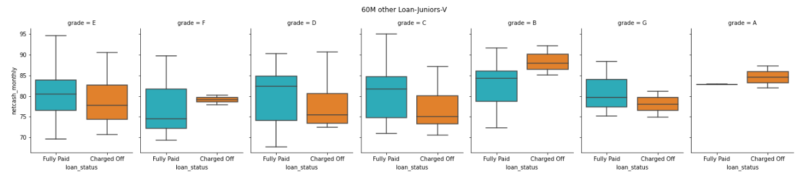
Multivariate Analysis: 60M-Other Loan
High possibility of default:
Applicants availing “B” grade loan who posses NCM <76%
Applicants availing “C” grade loan who posses NCM <84%
Applicants availing “D”, “E” grade loan who posses NCM <81% ,82%

Slide 23
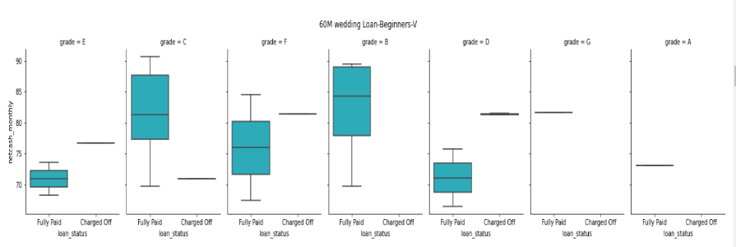
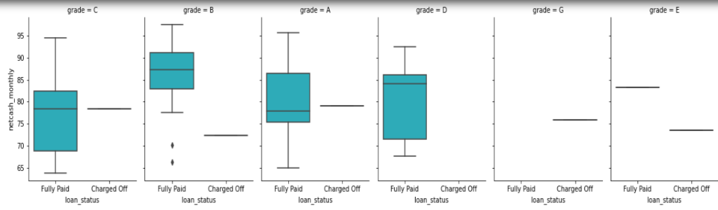
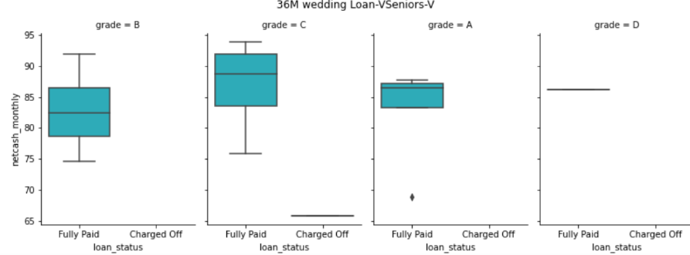
Multivariate Analysis: 36/60M-Wedding Loan
Overall default % in wedding loan is less compared to other loans
Applicants availing “B”, ”D” grade loan who possess NCM <88% most likely to default in the Beginners or Junior category

Slide 24
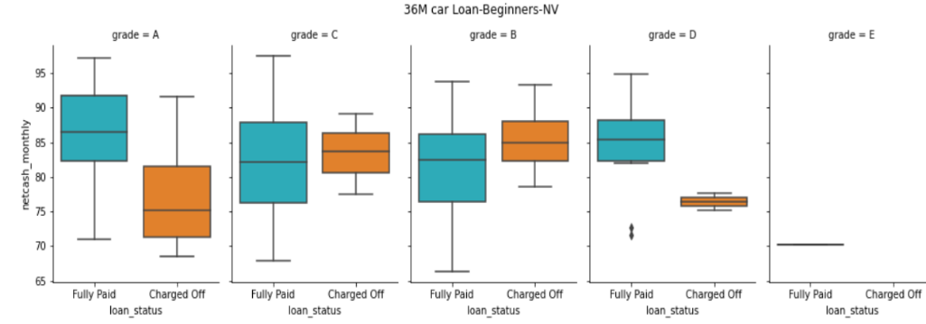
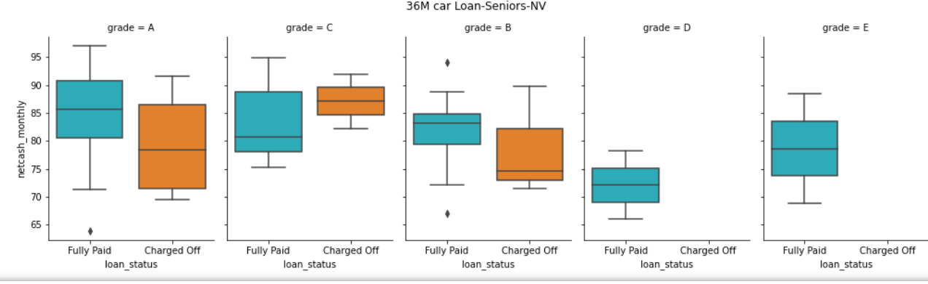
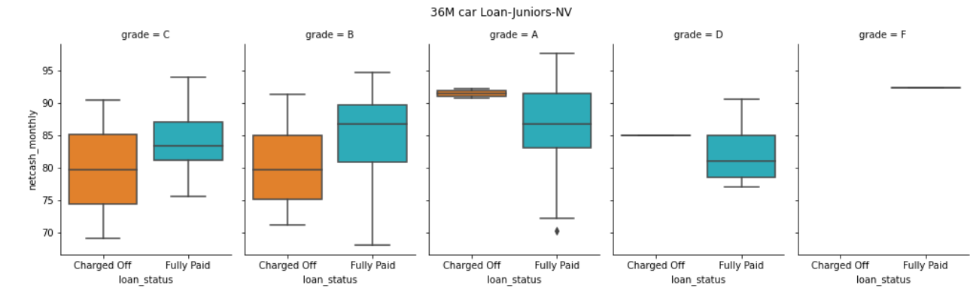
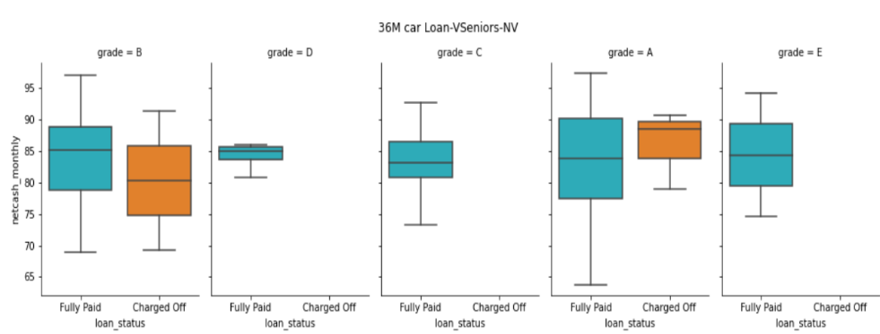
Multivariate Analysis: 36M- Car Loan
High possibility of default:
Most of the defaults are in Not-Verified category
Applicants availing “A”, “B” grade loan who posses NCM <78%
Applicants availing “C” grade loan who posses NCM <84%

Slide 25



Multivariate Analysis: 60M- Car Loan
High possibility of default:
Most of the defaults are in Not-Verified category
Applicants availing “B”, “C”, “D” grade loan who posses NCM <82%, 80%, 86%

Slide 26




Multivariate Analysis: 36M- Debit Consolidation Loan
High possibility of default by:
Most availed loan with highest vol% of defaulter in Verified and Not Verified category
Applicants availing “A”, “D” grade loan who posses NCM <75%
Applicants availing “B”, “C” grade loan who posses NCM <73%
Applicants availing “E” grade loan who posses NCM < 78%

Slide 27




Multivariate Analysis: 60M- Debit Consolidation Loan
High possibility of default by:
Most availed loan with high vol% of defaulters in Verified and Not Verified Category
Applicants availing “B”, “D” grade loan who posses NCM <73%
Applicants availing “A”, “E”, “F”, “G” grade loan who posses NCM <75%
Applicants availing “C” grade loan who posses NCM <74%

Slide 28




Multivariate Analysis: 36M- Home Improvement Loan
High possibility of default by:
More % of defaulters in Not Verified category compared to Verified category
Applicants availing “B”, “C” grade loan who posses NCM <80%, <78%
More % of defaulters in “B” & “C” loan compared to “A” / ”D” loan

Slide 29




Multivariate Analysis: 60M- Home Improvement Loan
High possibility of default by:
Compared to 36M loan the defaulter % is less
Applicants availing “B” grade loan who posses NCM <84%
Applicants availing “C” grade loan who posses NCM <81%
Applicants availing “D” grade loan who posses NCM <85%

Slide 30




Multivariate Analysis: 36M-Major Purchase Loan
High possibility of default by:
% default by Juniors is less compared to others
Applicants availing “A”, “C” grade loan who posses NCM <82%
Applicants availing “B” grade loan who posses NCM <80%
Applicants availing “D” loan who posses NCM <90%

Slide 31




Multivariate Analysis: 60M-Major Purchase Loan
High possibility of default by:
% defaulters in Seniors, Vseniors is less compared to Beginners & Juniors
Applicants availing “C” grade loan who posses NCM <82%
Applicants availing “D” grade loan who posses NCM <83%
More % of defaulters in “B” & “C” loans compared to other loans

Slide 32




Multivariate Analysis: 36M-Medical Loan
High possibility of default:
Beginners availing “B” grade loan who posses NCM <78%
Verified juniors, seniors and vseniors are not likely to default
Most of the defaulters are in Not-Verified category

Slide 33



Multivariate Analysis: 60M-Medical Loan
High possibility of default:
Very less % of defaulters overall
Only applicants in Not-Verified category are defaulting

Slide 34



Multivariate Analysis: 36/60M-Moving Loan
High possibility of default:
Most of the Verified loan applicants are not likely to default
Most of the defaulters in moving loan are in Not-Verified category
Very less % of defaulters compared to other loan

Slide 35




Multivariate Analysis: 36/60M-Vacation Loan
High possibility of default:
Most of the Verified loan applicants are not likely to default
Very less % of defaulters compared to other loans
Most of the defaulters in vacation loan are in Not-Verified category

Slide 36




Multivariate Analysis: 36/60M-House Loan
High possibility of default by:
Most of the Verified loan applicants are not likely to default
Very less % of defaulters compared to other loan
Most of the defaulters in Not verified category

Slide 37


Multivariate Analysis: 36/60M-Educational Loan
High possibility of default:
Most of the loan applicants are not likely to default
Very less % of defaulters compared to other loans
Likely defaulters in Not Verified category

Slide 38


Multivariate Analysis: 36/60M-Renewable Energy Loan
High possibility of default:
Most of the verified loan applicants are not likely to default
Most likely defaulters of RE loans are in Not Verified category
Very less % of applicants and defaulters

Slide 39
Thank You!

